Slide 2
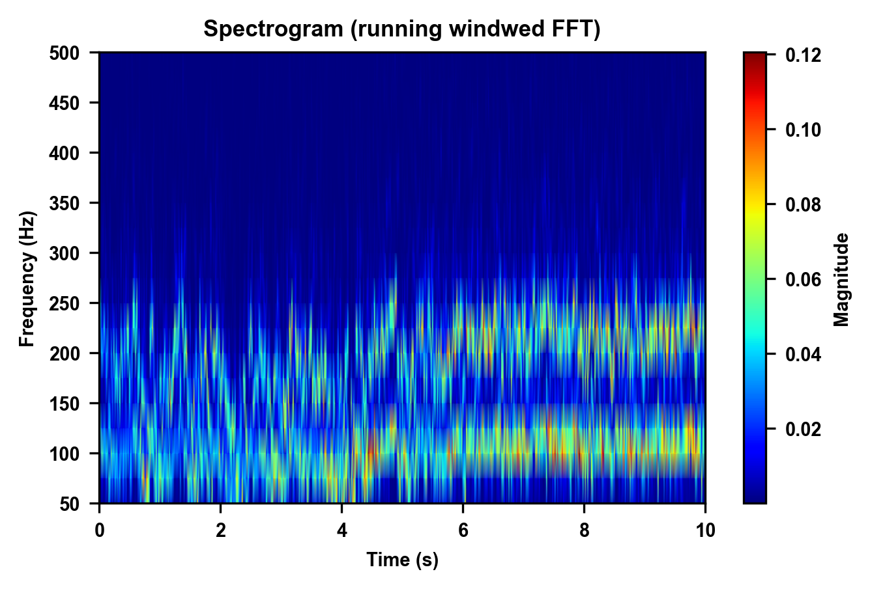
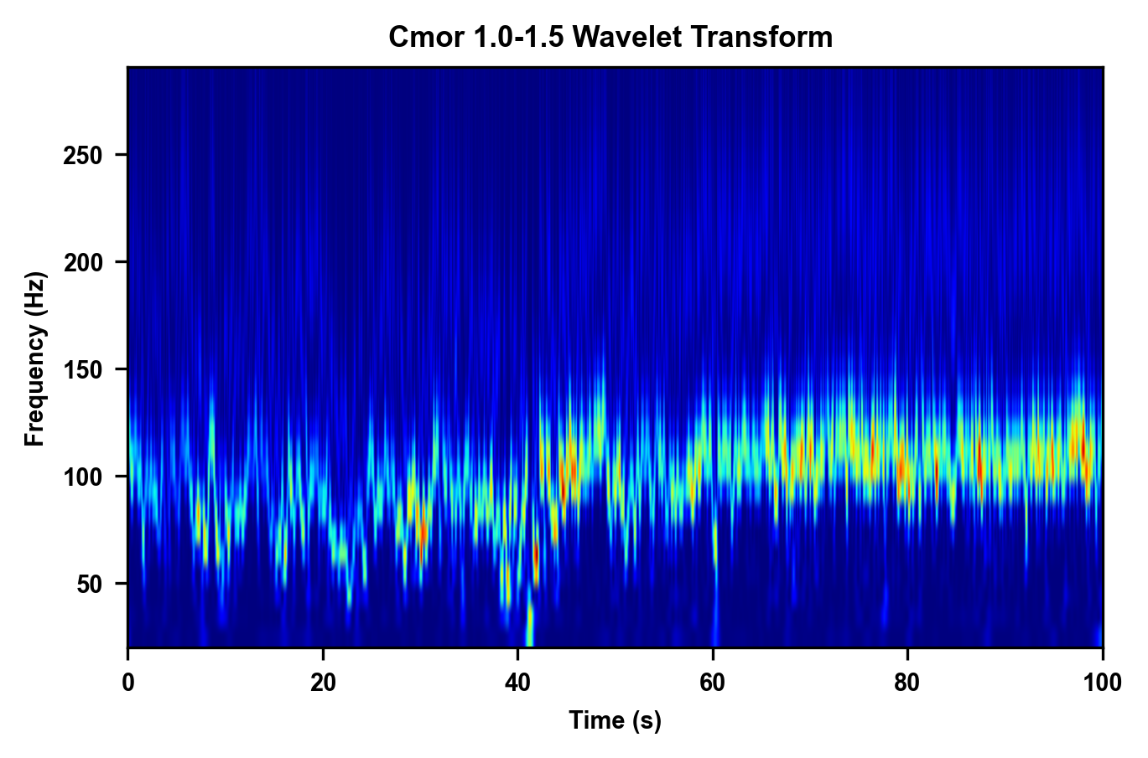
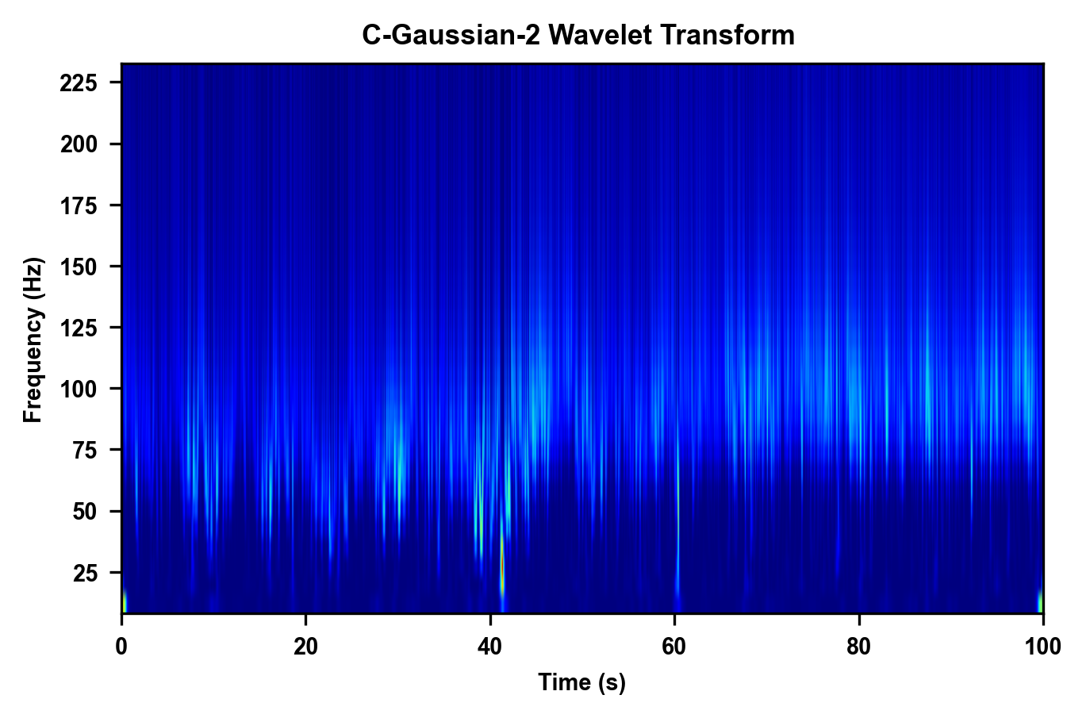
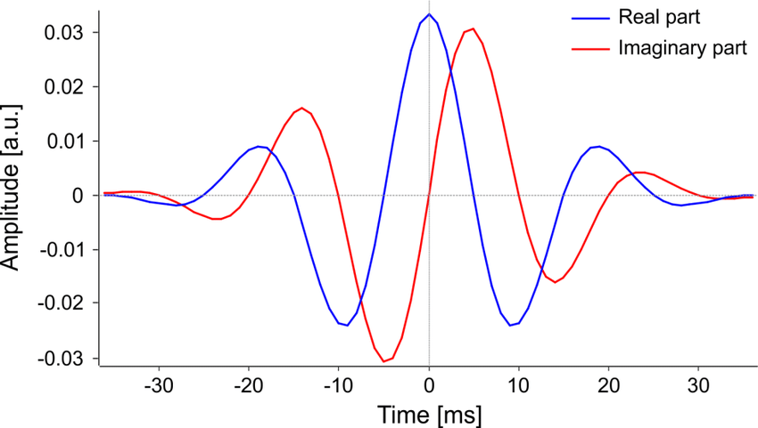
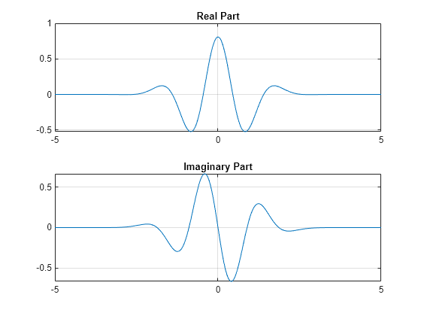
Old work, lots of data, not finished and needing wrap-up.
In the bearing paper we focus on « helicopter golds », meaning that they rotate parallel to the surface. Necessary to get homoegenous angle resolution, easy to analyze but very rare.
Most of the data are not helicopter gold, how do we analyze them ?
Spectral methods work but are not great.

Slide 3
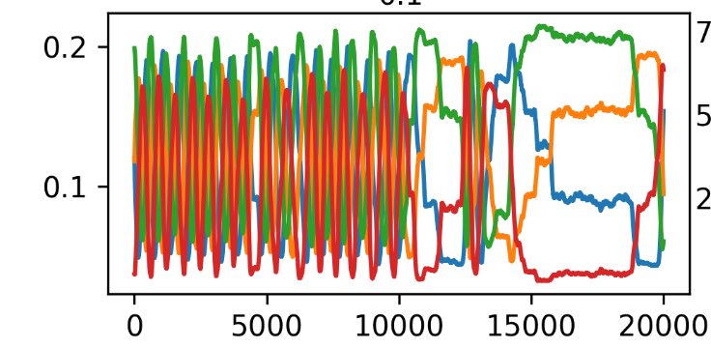
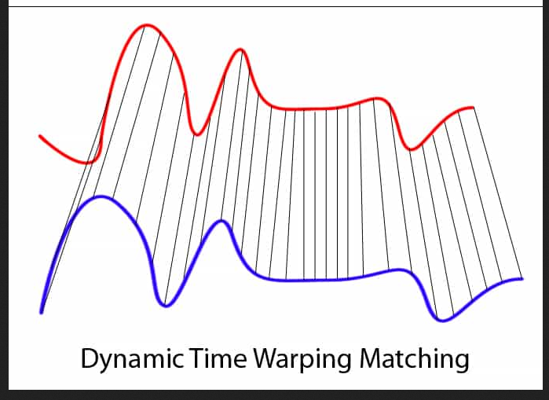
Why aren’t spectral method great ? Because a lot of pauses and change of period.
An alternative : time warping, used in electro cardiograms. To find a repeated pattern which can be dilated.
TOO EXPENSIVE Computationnally !

Slide 4
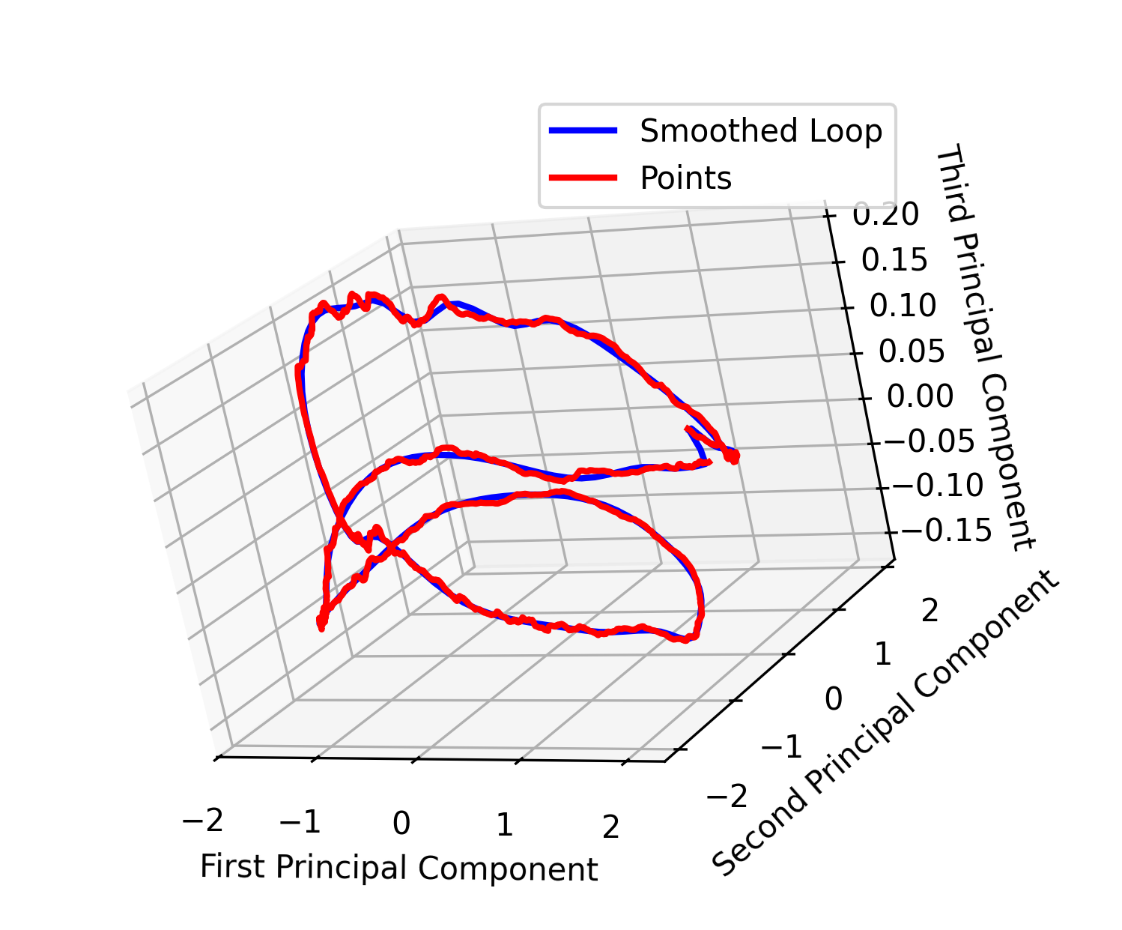
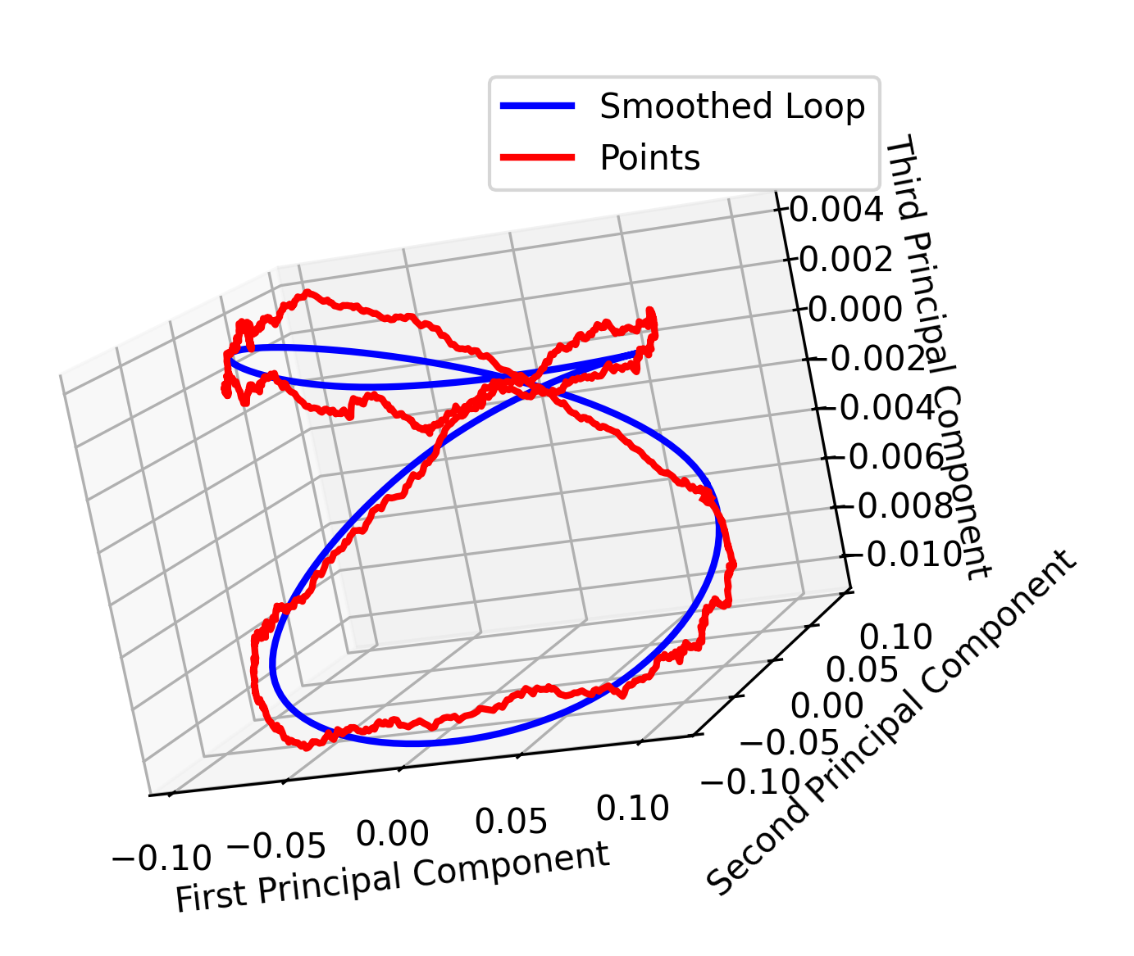
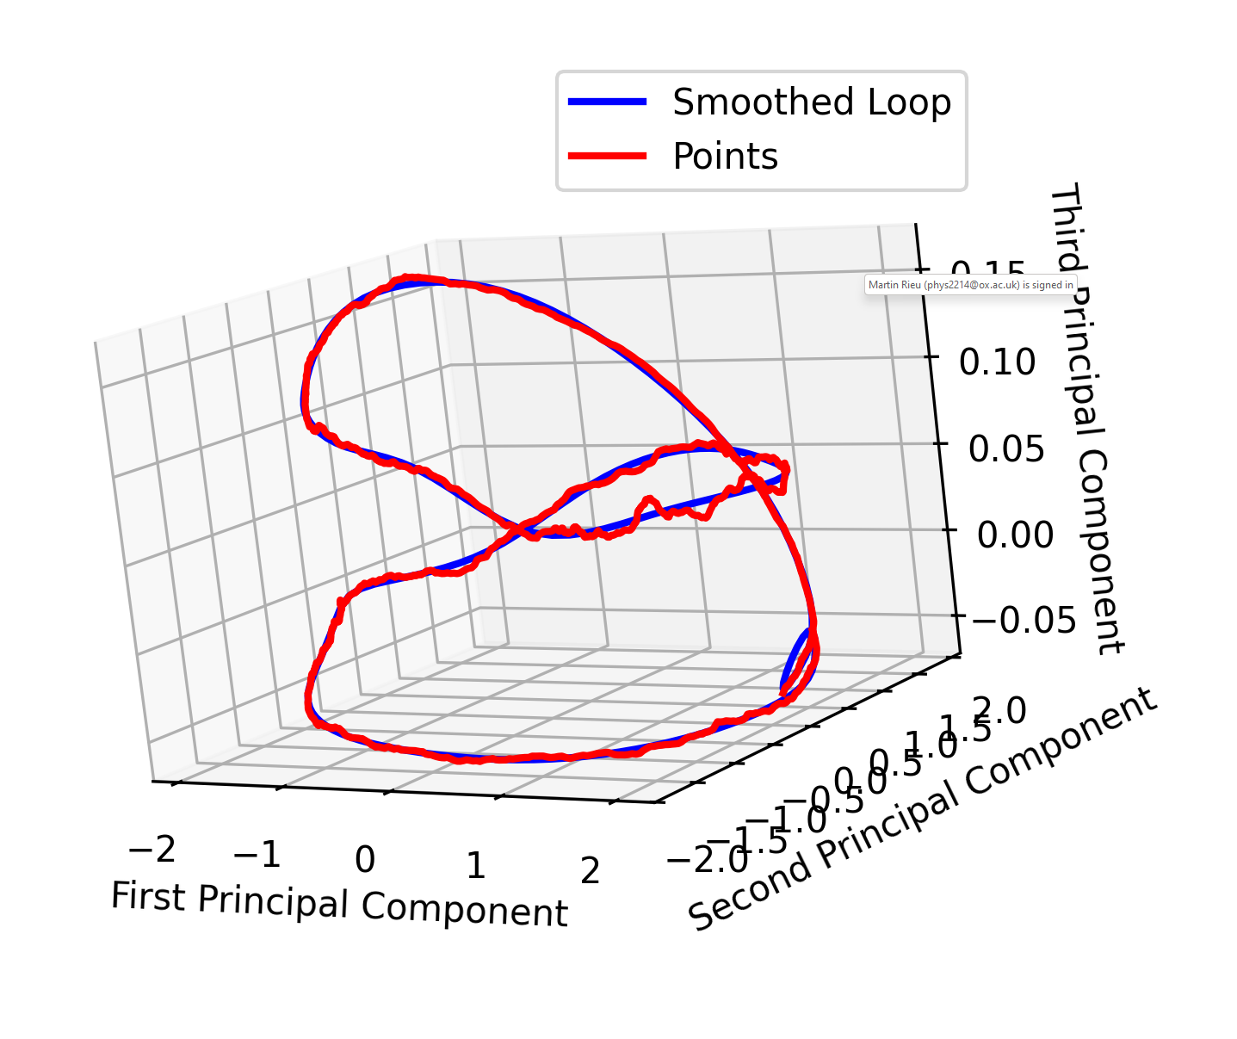
Instead of relying on spectral analysis or DTW, we can leverage the spatial repetition of signal trajectories using Principal Component Analysis (PCA) and mapping techniques.
Key Properties of the Data:
Not regular in time but repeated in space: The system always follows similar phase transitions (e.g., combinations of orientations (C0,C90,C45,C135)(C_0, C_{90}, C_{45}, C_{135})(C0​,C90​,C45​,C135​)).
Continuous transitions: The system does not jump between states arbitrarily; it moves smoothly through intermediate phases, avoiding self-crossing.
Principal
Component
Analysis
Trajectory
In 3D PCA Space
(no time)
Find a smallest
Repeating unit
(least trivial step)
Smooth the trajectory and
Parametrize it
with a single parameter s, discretized
In N smoothing steps
Raw signal
1D parameter trajectory
Mapping New Data to the Smoothed Trajectory:
Associate each new point Pol[i+1]to the closest mapped location s[j] sensuring smooth transitions
Take raw signal
Pol[0] and associate to the
Start of the smoothed trajectory s[0]
ALSO update the smoothed trajectory
Every~ 1s using the mapping
To correct for slow
Drifts !

Slide 5
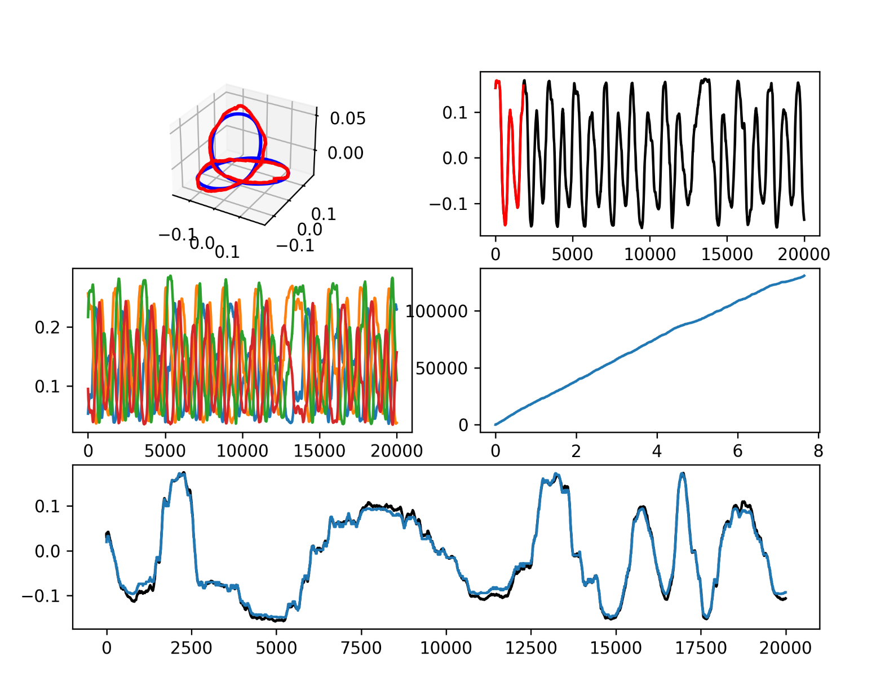
Map[t]
Black : PCA_0[t] (measured)
Blue : Trajectory[map[t]]
Blue comes from the same pattern, sampled so that it fits the signal the best. It is the SAME pattern taken at different positions.

Slide 6
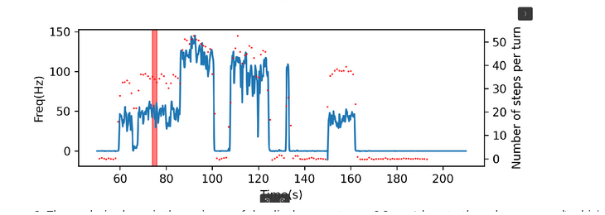
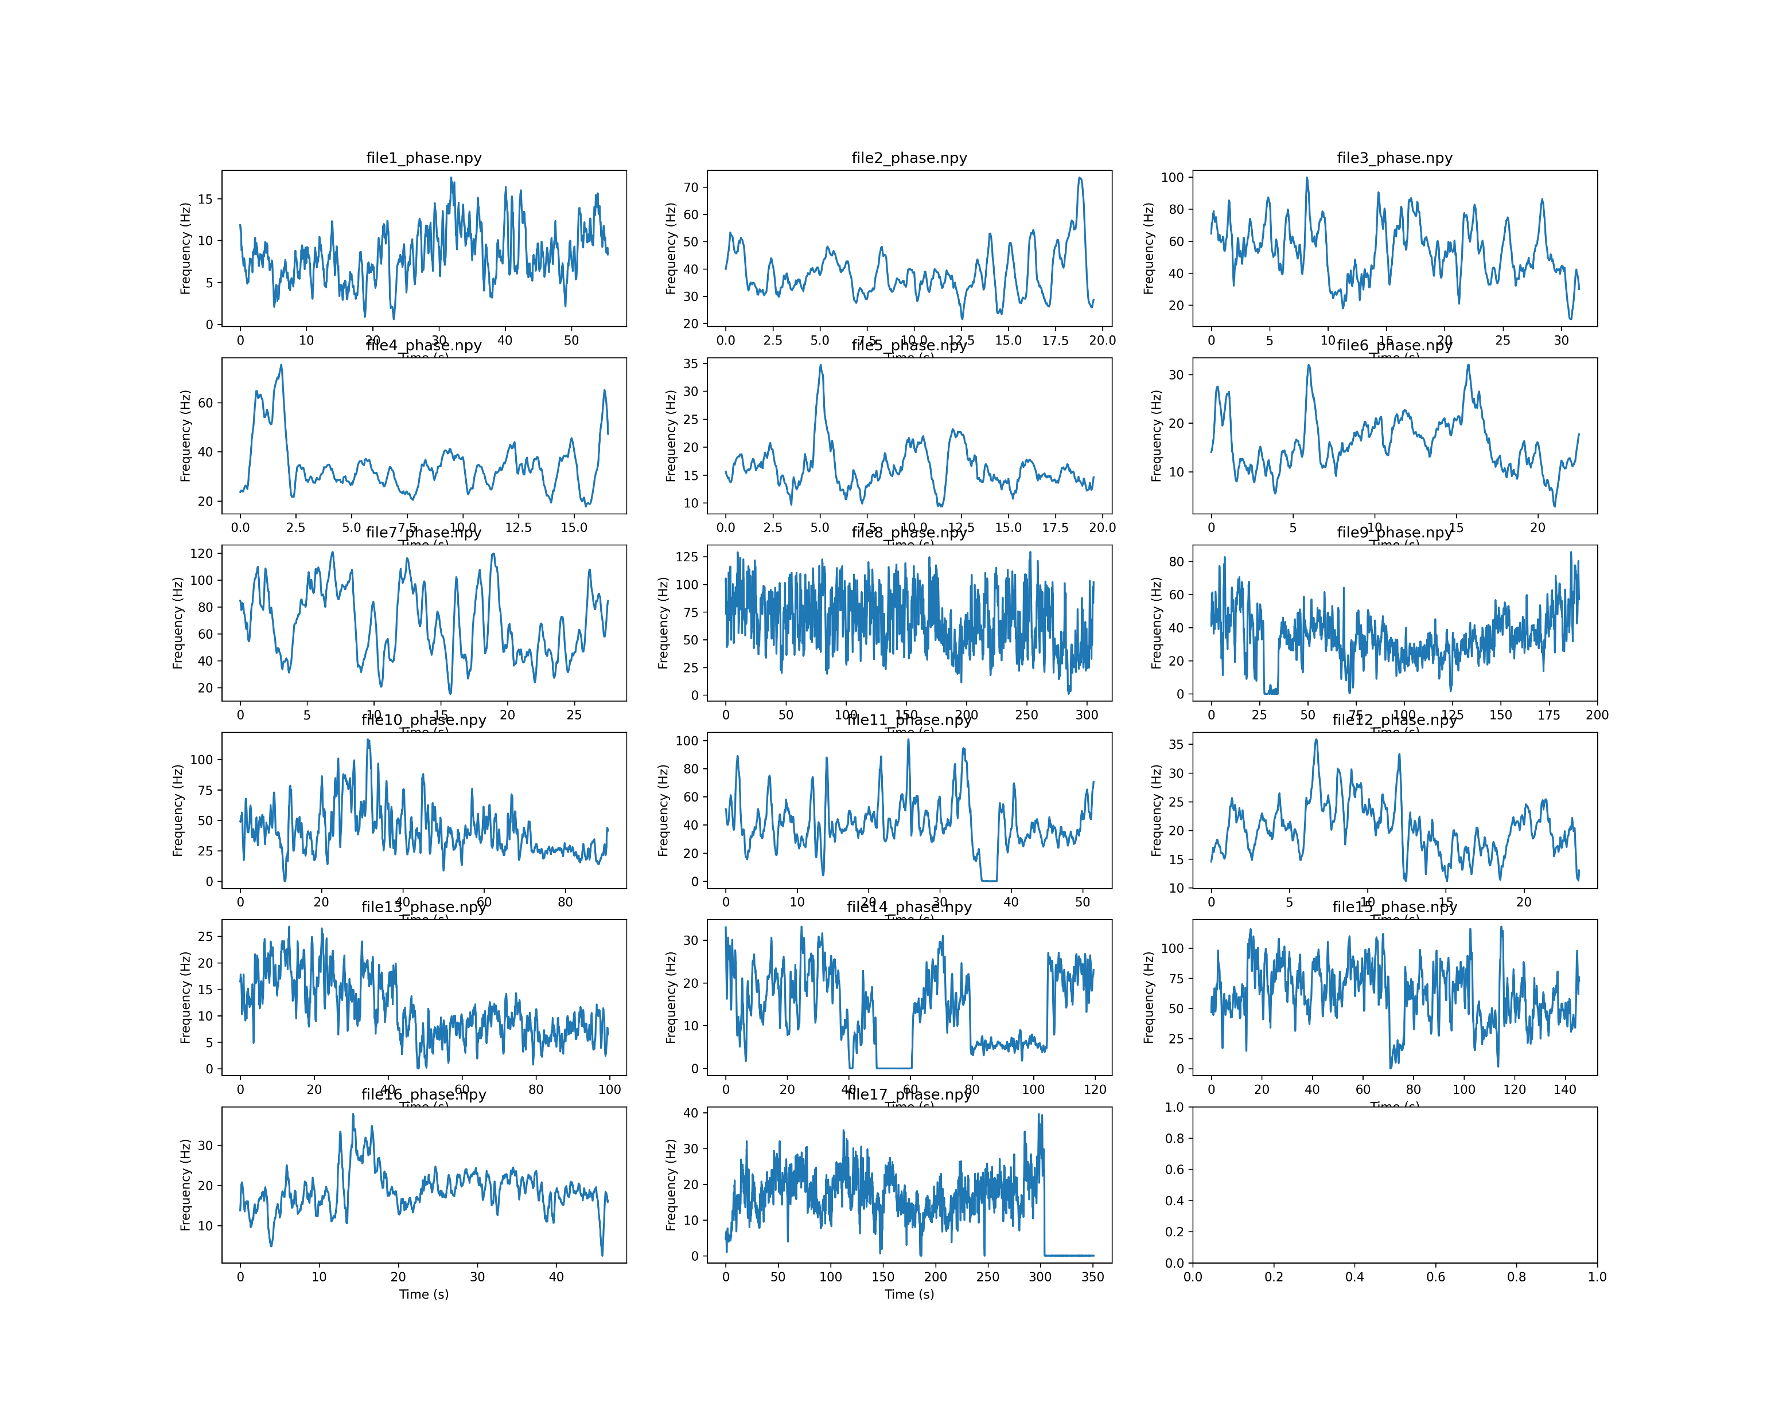
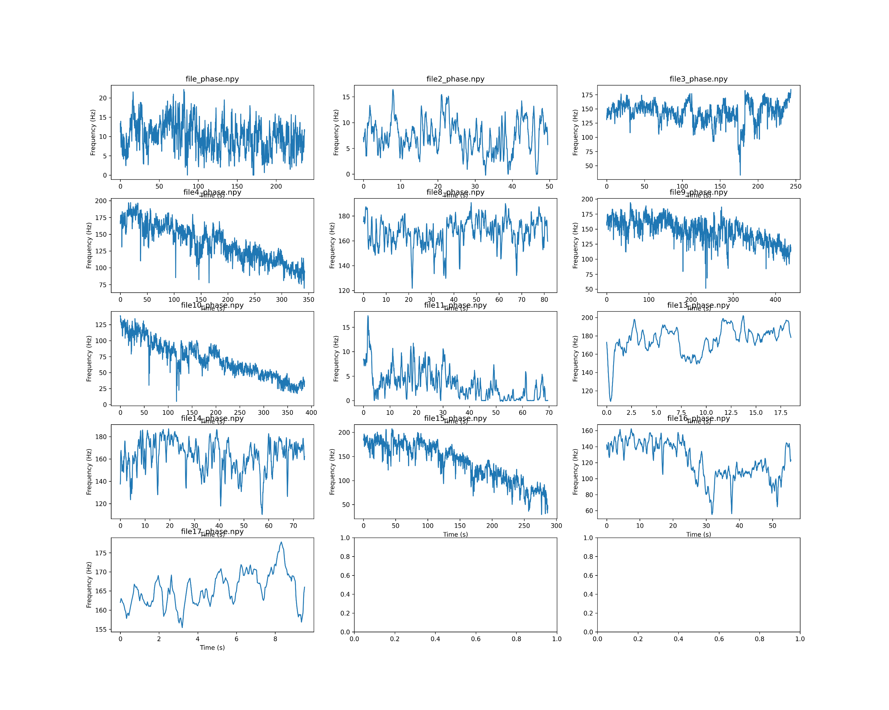
0.3 mM Arabinose
Unplugged mutant
Always main speed around ~160Hz as the wt.
(Compare to ~600 Hz for MTB24 at 80 mM NaCl)
Except a few rotating between 0 and 10.
MTB24 _ 5mM NaCl
Clockwise mutant MHR09
Goes far slower
Before found the oxygen scavenger mix – now resolved

